Slide 1
WPF Controls
Notes:
WPF Controls

Slide 2
Content
WPF Controls
Buttons
Content Model
Grouping Controls
Text Input
Range Controls
Items Controls
Items Control and Content Model
Items Container
Containers vs Elements
Events and Commands
Event Routing
Built-in Commands
Menus and commands
Menus
Styles
Templates
Animations
Advanced animations

Slide 3
WPF Controls
Default WPF control types:
Button
Text
Shapes
Containers
Media
Toolbars
Scrolls
Panels and lists
Miscellaneous

Slide 4
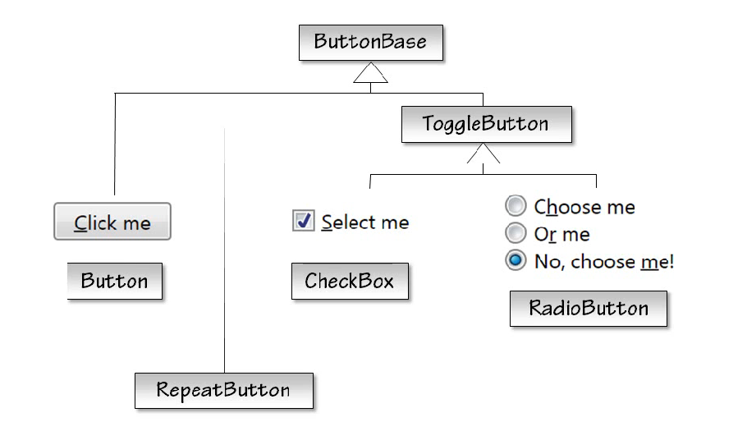
Buttons
Notes:
Buttons
As you've already seen, WPF offers the usual push button.
It also offers checkbox and radio button controls. And these all work much as you'd expect.
The most interesting things to see here are actually the other classes.
ButtonBase is the base class of all the buttons, and ToggleButton is the base class of buttons that provide a checked property.

Slide 5
WPF Controls
Normal controls
In System.Windows.Controls namespace
Ex. Button, CheckBox, RadioButton
Primitive controls
In System.Windows.Controls.Primitives
Contains base classes and controls that are intended to be used as part of other more complex controls
Ex. ButtonBase, RepeatButton, ToggleButton
Notes:
WPF Controls
Controls in WPF are divided into two groups / namespaces:
normal controls (System.Windows.Controls)
primitive controls (System.Windows.Controls.Primitives)
Normal controls are found in the System.Windows.Controls name space, and this is where you'll find the button, the checkbox and the radio button.
But there's also a System.Windows.Controls.Primitives name space which is where ButtonBase, ToggleButton and RepeatButton live.
Primitive controls are designed not to be used in their own, but as part of some other control.
For example, ButtonBase and ToggleButton are base classes of other controls.
And while RepeatButton is also a primitive, it's a little different. It's not a base class. It's a button that repeatedly raises its click event if you hold down the mouse button.
The reason it's in the primitives name space is that this is not a standard type of Windows control. The repeat button is used inside other controls such as a scroll bar.
You're free to use it as a standalone control if you want, it's merely in the primitives name space to indicate that its main reason for existing is to be a part of something else.

Slide 6
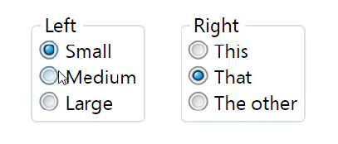
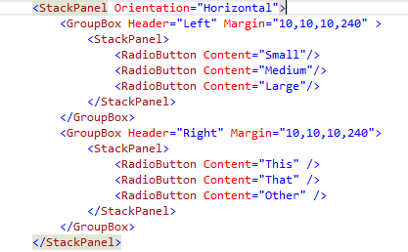
RadioButton example
RadioButtons with the
same parent are in
the same Group
(Left Group – Right Group)
Notes:
RadioButton Example
Radio buttons are designed to be used in groups where only one button in the group can be selected.
By default grouping is determined by containment. For example, I've got six radio buttons here in two group boxes. And as you'd expect they form two groups. I can select just one from the group on the left and just one from the group on the right. They form two distinct groups for mutual exclusion here. And I didn't have to do anything special to make this happen. It works because each group has got a different parent.
The buttons on the left here are all contained in this stack panel which is the child of the group box, it's the group box's content. And the other three are in a separate stack panel.
It's that parenting that decides that these things are in the same group as one another but not the same group from left to right.

Slide 7
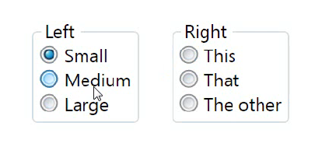
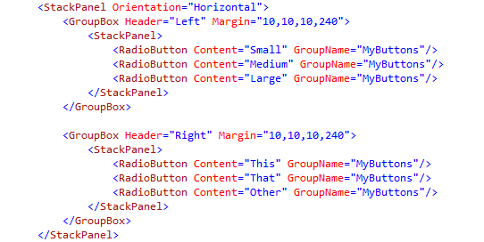
RadioButton example
You can override this with the GroupName property ➔ all RadioButtons in the same Group
Notes:
RadioButton Example
You can override the grouping if you wish.
You can specify a GroupName property.
If I set the group name here to be called MyButtons and set that across all of the radio buttons in both sets I now find that they act as a single group across the entire page.
So any radio buttons with the same group name will ignore their parenting and will act as one group.

Slide 8


Pluralsight video: Buttons

Slide 9
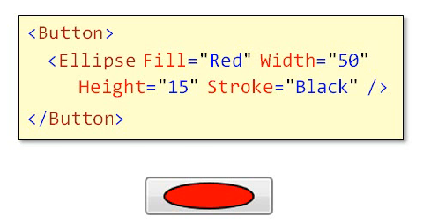

Buttons – Content Model
Flexible caption
Text
Arbitrary content (ex. Graphics,…)
Data
No limits, you can put anything you like inside a button
Not only for Buttons (Ubiquitous pattern)
Access Key
Notes:
Buttons – Content Model
As you saw in the introduction, buttons have a content model that allows anything to be used as the caption.
It might be plain text, or it could be graphics, or it could even be data.
As we'll see in the data binding chapter, you can put any object you like into control to support the content model.
The content model even lets you put in really bizarre combinations of content. For example, you can have a button that contains a stack panel which contains some text and some graphics, but this also contains a nested button, and inside the button as well as some text we have a menu. And the menu items themselves contain some further text but also an editable field. And just for good measure yet another button.
Of course, you should never build a user interface that looks like that. It's a crime against usability. But the important point here is that the button does not impose any arbitrary limits on its content.
You can put anything you like inside the button including things that make no kind of sense.
It's not just the button that offers this model. This content model is a ubiquitous pattern in WPF.
Not only do you need a lot of built in control support it, it's also easy to build to custom controls that work the same way.
One bonus feature of the content model that's worth remembering is that if you put plain text into the content you can stick an underscore in front of a letter to designate that as the accelerator key for this control.

Slide 10

WPFContentModel

Slide 11
Pluralsight video: Content Model

Slide 12
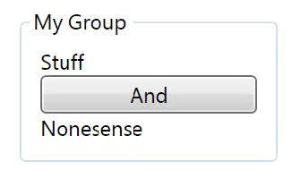
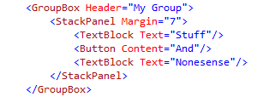
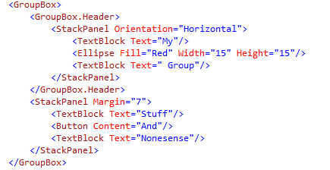
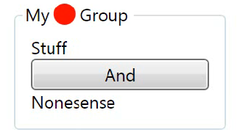
Grouping Controls
Notes:
Grouping Controls
Controls don't have to be limited to a single piece of content. Some controls have two.
There's a base class called HeaderedContentControl which offers both a content and a header property.
The Expander and GroupBox controls both derive from this class.
This means that as well as being able to put anything you'd like in the body of one of these controls, you can also use anything as the header. It doesn't just have to be plain text.
Now, to provide something more complex as the header, I'll need to use XAML's property element syntax. Remember, property element syntax lets me specify a tree of objects as the value of a property.
So I'm going to set the group box as header as more than just a string. I'll set it as in this case a stack panel oriented horizontally. And then inside the stack panel let's add some content.
Let's add a text block to put some text in there. Let's have an ellipse as well so we can have some graphics. And then a bit more text.
So there you see I can use exactly the same approach of putting arbitrary content into the header as I can use for the body itself. It's the same model, just in two different places.

Slide 13
Pluralsight video: Grouping Controls

Slide 14
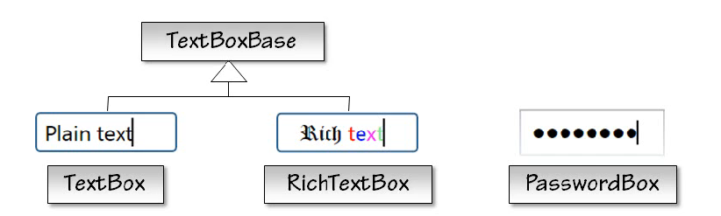
Text Input
Can include formatted
text, images, lists,
tables and more
does not allow cut, copy, undo
and redo commands
Notes:
Text Input
WPF provides three controls for handling text input:
The basic TextBox supports plain text. You can't add formatting which means its value will always be just a plain string.
If you want to allow fully formatted text there's the RichTextBox. Oddly enough, rich text box doesn't use the rich text format (RTF) internally despite the name. It uses WPF’s own flow document model for text formatting. This is a good thing because it's a lot easier to work with WPF’s native text object model than it is to work with RTF. The main reason the control is called a rich text box is that this is what Windows has always called the text box that supports formatted text. In fact, there is support for the rich text format via the clipboard. If you paste RTF into a rich text box it will convert that into a flow document at run time. And if you copy content from a WPF rich text box, it offers RTF as one of the export formats on the clipboard. So it still supports RTF, it just doesn't use it as its internal model. Both TextBox and RichTextBox share a base class (TextBoxBase), so they offer a common set of editing methods like copying, pasting and deletion.
There's a third kind of text box which does not share the same base, the PasswordBox. As the name suggests, this is designed for editing passwords. So it shows blobs rather than the letters you typed in. The reason it doesn't share a base class is that it doesn't want to offer certain clipboard operations such as copy and cut. It would be a security risk to allow a password to be copied to the clipboard.

Slide 15
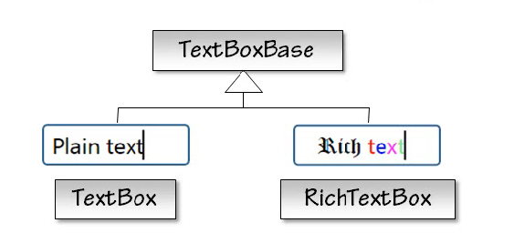
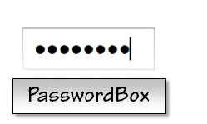
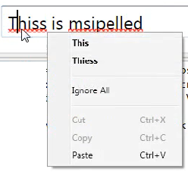
Text Input
spell-checking choices in the context menu (right click)
spelling suggestions or the option to Ignore All
Support for several flavours of English (US, Canadian, British and Australian English), German and French

Slide 16
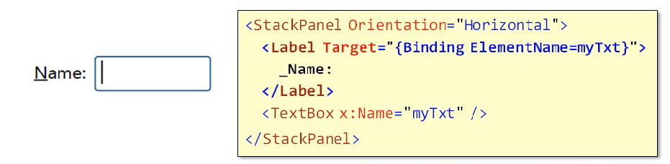
Text Input - Label
TextBlock control doesn't support Access Keys, but the Label does
Alt-N will give the focus to the TextBox
Only purpose of a Label = handling focus, otherwise use a TextBlock

Slide 17
Pluralsight video: Text Input

Slide 18
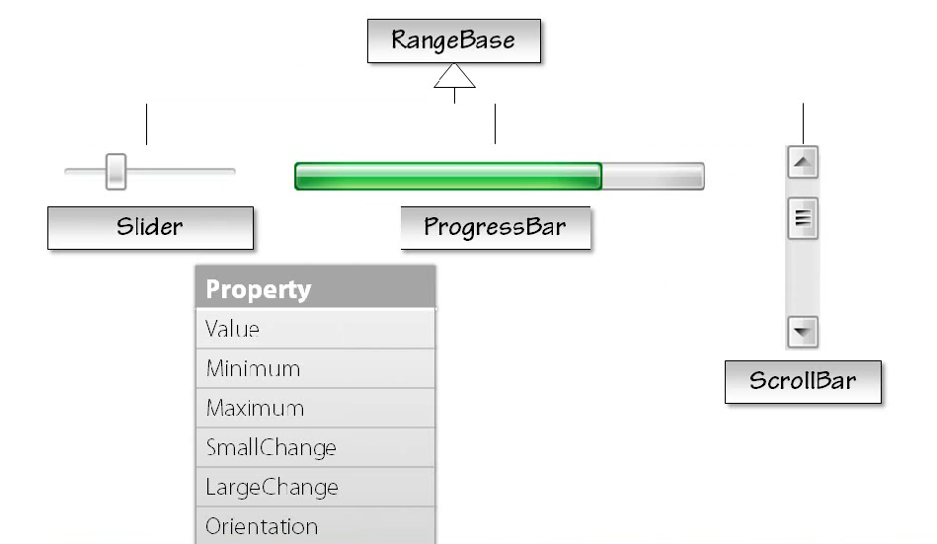
Range Controls
Notes:
Range Controls
There's a related set of controls called the range controls.
Scroll bars, sliders and progress bars all have a certain amount in common. They all represent a value that lies within a range.
Two of them allow the value to be changed by dragging. Sadly, you can't drag a progress bar to make things run faster. But in other respects it's very similar to the slider in the scroll bars.
So they all share a common base class (RangeBase) so that they can provide a common set of properties.

Slide 19
Pluralsight video: Range Controls

Slide 20
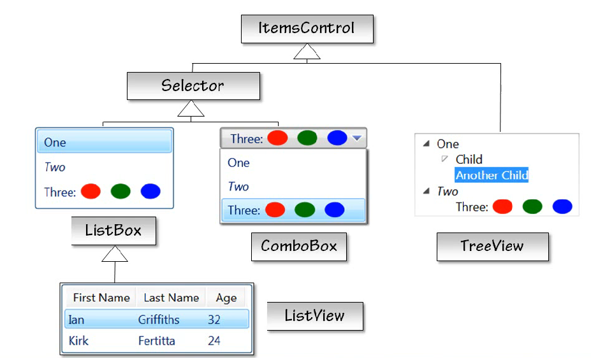
Items Controls
Items Property to hold the collection of child items
Common sets of events
Data Binding
ListBox – ComboBox:
derive from (indexed) Selector
TreeView: own Selection Model
ListBox – ListView : same capabilities except column headers
Similar Content Model than Button, but works for any number of child items
Notes:
Items Controls
Many controls in WPF can display multiple items.
For example, ListBox, ListView, ComboBox and TreeView all shown here.
They all derive from a common base class, ItemsControl.
This base class provides an Items property to hold the collection of child items along with a common set of events and also data binding support.
Derived from items control we have Selector. This adds properties to handle a selected item.
It may seem odd that tree view does not derive from this because you can select items in tree views as well. The explanation is the selector has a slightly misleading name. It would be more accurate to call it something like indexed selector.
It offers a SelectedIndex property, so its selection model only makes sense for linear lists of items.
With the tree view it's not necessarily clear what, say, the 23rd item in the tree is. There's more than one ordering for a tree of items. And in any case if some expandable nodes have not yet been expanded you don't necessarily even know how many nodes there are in total. So tree view implements its own selection model which does not depend on the idea of a numbered item. And this is why it's often its own path to class hierarchy.
Notice that ListView derives from ListBox. In WPF the difference between these two controls is much smaller than in win32. The list box can support most of the scenarios that the list view is originally designed for.
The only thing WPF ListViews adds that the basic ListBox cannot offer is support for column headers.
All items controls are for a content model that's similar to the one we saw for button but which works for any number of child items.

Slide 21
Pluralsight video: Items Controls

Slide 22
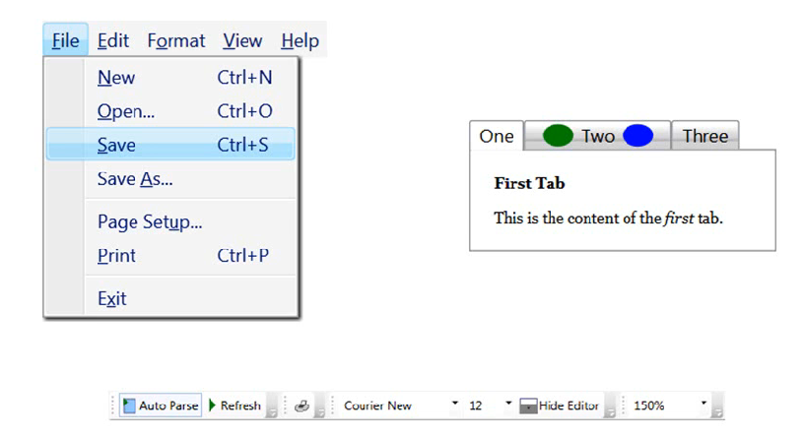
More Item Controls
Menu
Notes:
More Item Controls
Some slightly less obvious controls also turn out to be items controls.
For example, menus share a lot in common with tree views. They both present trees and information.
So whereas a tree view has a series of nodes, each of which might have child modes, menus have a series of menu items, each of which could contain a submenu.
Although the visuals and interactions are quite different, structurally they are very similar. And so from a developer's perspective they're almost identical.
You can generate menus using data binding exactly the same way that you can with a tree view.
Tab controls are also items controls. In fact, tab control derives from selector, the same base class as the list box and combo box.
The relationship may not be immediately obvious because the layout and behavior seem quite different. But if you think about it it's clear that a tab control presents a set of items and allows one to be selected at any one time.
So it makes sense for it to derive from the same base class as list box and combo box because those have the same selection model.
Toolbar also derives from ItemsControl. So, again, you can generate tool bar content with data binding as well.

Slide 23
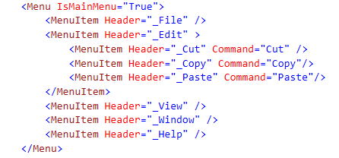
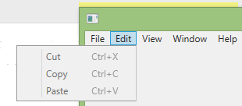
Menu Control

Slide 24
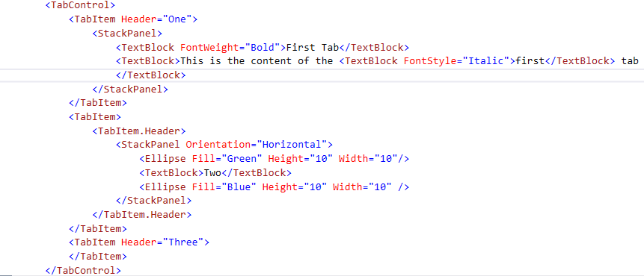
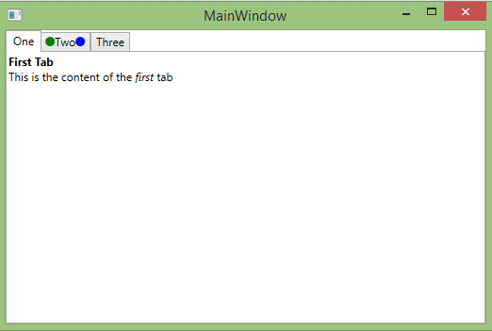
Tab Control

Slide 25
Pluralsight video: More Items Controls

Slide 26
Items Controls and Content Models
Content Model | Used By
Content Control | Button, Label | A single (arbitrary) object
Headered Content Control | GroupBox, TabItem | A header and a single item (both of which are arbitrary objects)
Items Control | ListBox, ComboBox | A collection of arbitrary objects
Headered Items Control | MenuItem, TreeViewItem | A header and a collection of items, all of which are arbitrary objects
Notes:
Item Controls and Content Models
We've seen a few variations on the content model idea.
In fact, we've seen the four most common ones now. So let's review them.
The simplest model is offered by the ContentControl base class. This provides a single content property. And this is the base class of button and label. And perhaps less obviously it's also the base class of window. After all, window is a visual element with some content.
Then we have HeaderedContentControl, another base class. This derives from ContentControl and adds a content property providing a jewel content model. So this is the base of things like the expander and group box and also tab item.
Then there's the ItemsControl base class which provides a multi-content model. Each item in the list gets its own instance of this content model idea.
And then finally there’s HeaderedItemsControl. This derives from ItemsControl but then adds in a header just like headered content control does for the base content control. So headered items control is used by items that have children and also a distinct header. Tree view items derive from this. Tree view items have a header which holds the caption for the node and children which is any child tree nodes. And menu item is the same. The header displays the text you see for the menu item. And then the children property contains the contents of the submenu.
It's technically possible to introduce new content models. All the hard work here is actually done by WPF’s content presenter element which ends up going inside the control template.
You are free to use as many content presenters as you like. However, unless you have a particularly good reason to do something unusual it might be easier for your fellow developers to understand your code if you try to stick to one of these common content models instead of inventing new ones.

Slide 27
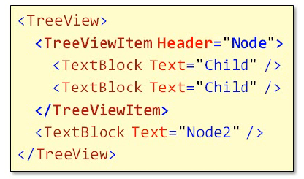
Item Containers
Items always wrapped
Generated automatically
Control | Container
ListBox | ListBoxItem
ListView | ListViewItem
TreeView | TreeViewItem
Etc. | Etc.
Notes:
Item Containers
It turns out that the way items controls offer the content model to each individual child is that each child gets wrapped in its own nested control.
So for every item you add to a list box the list box wraps it in a list box item control.
Likewise, the list view wraps children in a list view items control and so on.
These wrappers are called item containers, and they're always present. Each items control defines its own container type.
Now, while these are generated for you, you can supply your own, and this gives you control over the properties of the container.
One case where this can be important is the tree view. If you just add a bunch of child objects to a tree view they end up being the header property of the generated tree view item.
So none of the child items will have children of their own. Your tree view will be just one level deep which isn't much of a tree.
If you're populating the tree view manually you will normally want to bring your own container. If I add a text block to this tree view it appears as a node in the tree. If I've got a child inside the text block like this it's treated as just that, as a child of the text block itself. It does not appear as a child node. If I want to add a proper child in the tree view then I need to define the structure completely. I need to define the tree item myself so that I can take control. I have to build an explicit tree view item. I have to tell WPF which bit is the header. So, again, I'm using the property element syntax here to let it know that that text block is meant to be the header for this item. And then the children of the tree view item become further nodes in the tree beneath this node. So I can now say header equals child one, for example. And you can see that my tree view has grown the expander icon so I can expand that, and we can see child one there. And if I have a second child item we get two children. So I'm being explicit about which piece is the header for each item and which items are children. And I can only do this by bringing my own containers for the tree view.

Slide 28
WPFTreeView

Slide 29
Pluralsight video: Item containers

Slide 30
Controls vs Elements
Not all elements are controls
Most elements derive from FrameworkElement
Only types that derive from Control are those with some specific interaction model
Only Controls support templates (Primitive elements don’t) to replace their appearance (i.e. you can change appearance of a button (=control), but not the appearance of an ellipse (= element, not a control).
Notes:
Controls vs Elements
We've now looked at examples of the most common categories of controls in WPF. Just to recap, most elements in WPF are not controls at all.
Most elements derive directly from FrameworkElement. The only types that derive from control are those with some specific interaction model, things that we'll use, I can see and can do things to.
And as we saw earlier, only controls have templates.
So whereas a primitive element such as an ellipse can never look anything other than ellipse-like, controls support templates allowing us to replace their appearance while retaining their intrinsic behavior.

Slide 31
Pluralsight video: Controls vs Elements

Slide 32
Events and Commands
Do something when user interacts with element or control ➔ events and commands
Events: low level user actions: moving the mouse, pressing a key
Commands:
higher level actions such as Copy, Paste, Print, Open, Save, …
operations that might be invoked through any number of different specific user interactions
Out of sope for this course
Notes:
Events and Commands
How do we make our code do things when the user interacts with elements for controls?
There are two mechanisms here, events and commands.
Events tend to be used for low level user actions such as moving the mouse or pressing a key or bringing the stylus near the screen.
Commands are for a higher level of abstraction.
A command represents an action such as copy or paste, print, open, save and so on, operations that might be invoked through any number of different specific user interactions.
We will not focus on commands in this course.

Slide 33
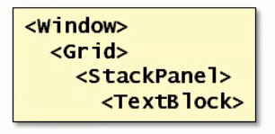
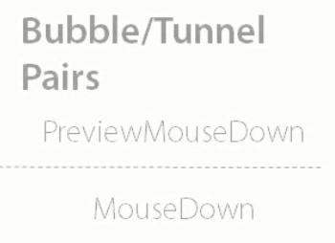
Event Routing
Tunneling
Previews
Bubbling
Main event
Direct
MouseEnter
Notes:
Event Routing
Your application will often need to respond to the user inputs to be of any use.
As you’ve seen in the previous slide, WPF provides two abstractions for handling input, events and commands.
Events are closely tied into the visual tree.
Mouse and keyboard input always originate from some particular user interface element.
The one with the focus (for keyboard input) and the one that the mouse pointer is over for other input.
The visual tree can get quite complicated and you wouldn't want to have to attach a handler to every single element in the visual tree for a control just to ensure that you receive input.
So WPF offers event routing to simplify input handling in the face of visual complexity.
Event routing allows events to be handled by an ancestor of the element that originally raised the event.
There are a couple of routine patterns, tunneling and bubbling:
A tunneling event starts from the very root of the visual tree and works its way through the tree to the element of which the event is already targeted. For example, a tunneling event representing a mouse button press would first be offered to the window and then to the child of the window and so on until it reaches the target element.
Conversely a bubbling event starts from the target and then bubbles up the tree until it finds an element that wants to handle the event.
Events come in pairs. There's usually a preview event that tunnels followed by a main event that bubbles.
The idea of the preview is to give containing elements the first opportunity to respond to an event.
So if you've written the code for a particular window you might want the chance to do something when the mouse is clicked before the control being clicked responds itself.
So you could handle the preview mouse down at the window level.
And then the bubbling event is usually the main one.
It has the simpler name like mouse down in this particular case.
So when the mouse is pressed, once the preview's been raised, WPF just walks up the tree looking for the first element that has asked to handle this event.
This means that if your control has very complex visuals, it can handle mouse activity with just one set of handlers, because all of the mouse events will eventually bubble out of those complex visuals and into the containing control.
You can handle events using the usual C# events syntax.
Direct event doesn’t route at all, it directs the event straight of the target and nowhere else.
Direct routing events are used for special cases where bubbling would not make sense.
For example, consider the mouse enter event. If you attach that to a window you could reasonably expect to get that event each time the mouse moved into the window from outside.
And that's exactly what does happen. But imagine what would happen if the mouse enter event bubbled.
Each time you move the mouse from one element inside the window to a different element in the same window the element you just moved will also raise a mouse enter event, and if that event were to bubble it would go all the way up to the root window element unless something happened to handle it first.
So by default the window would receive a mouse enter event any time the mouse cursor moved from one element to another anywhere inside the window which is probably not what most people would expect in that event.
So that's why mouse enter uses direct rooting. It's only raised for the target elements because bubbling would be actively confusing. And that's what direct rooting gets used for.

Slide 34
Pluralsight video’s: Events and Commands Event Routing
Notes:
Intro: https://app.pluralsight.com/player?author=ian-griffiths&name=wpf-controls&clip=12&course=wpf-fundamentals
Event Routing: https://app.pluralsight.com/player?author=ian-griffiths&name=wpf-controls&clip=13&course=wpf-fundamentals

Slide 35
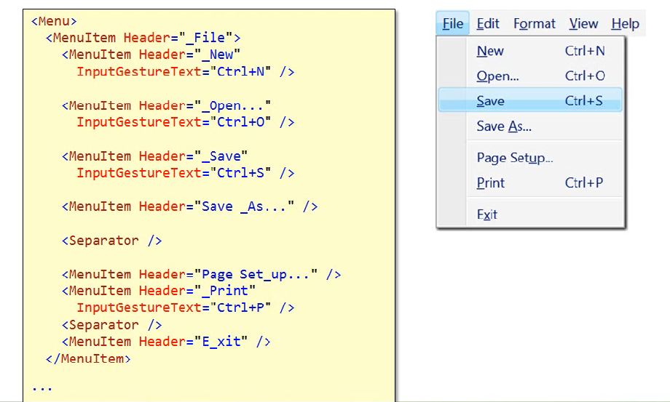
Menus
Not required to use commands
Notes:
Menus
Menu items are for a click event, and you can handle selections that way if you prefer.
And if you want to make a keyboard shortcut show up even though you're not using the command system, you can do this by setting the input gesture text property of the menu item, and that lets you control what shows up in the column of the keyboard shortcut.

Slide 36
Pluralsight video: Menus

Slide 37

Styles
a convenient way to apply a set of property values to more than one element.
XAML:
Code-Behind:

Slide 38
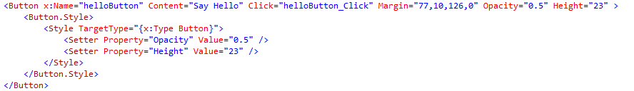
Styles
Using Style :

Slide 39
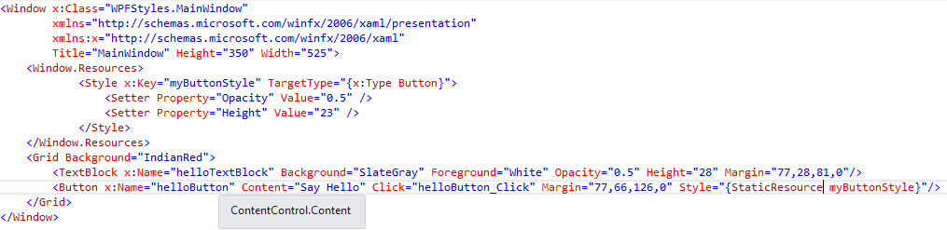
Styles
You can reuse this style for multiple elements (of the same type (TargetType=Button))
Notes:
See example 19-3…

Slide 40
Templates
Data Templates (zie later)
Control Templates:
defines the appearance of the control
You can change the structure and appearance of a control by defining a new ControlTemplate for the control
Changes that you can make by setting properties are limited
Notes:
See
https://app.pluralsight.com/player?course=wpf-fundamentals&author=ian-griffiths&name=wpf-introduction&clip=8
https://app.pluralsight.com/player?course=wpf-fundamentals&author=ian-griffiths&name=wpf-templates
Clip 0: Control Templates
Clip 1: Customization Continuum
Clip 2: Lookless Controls
Clip 3: Controll Templates
Clip 4: TemplateBinding
Clip 10: ContentPresenter

Slide 41
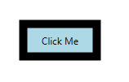
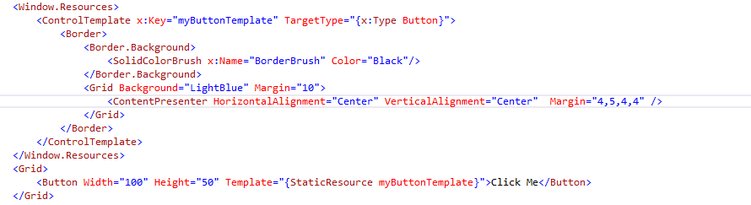
Templates
Button met ContentTemplate

Slide 42
Animations (Rectangle color)
Define a square
<Rectangle Name="myRectangle" Width="100" Height="100“>
</Rectangle>
Define a brush (needed to trigger an event)
Not possible with fill property
<Rectangle Name="myRectangle" Width="100" Height="100">
<Rectangle.Fill>
<SolidColorBrush x:Name="rectangleBrush" Color="Blue" />
</Rectangle.Fill>
</Rectangle>

Slide 43
Animations (Rectangle color)
Trigger needs to start the animation.
Triggers are simular to event handlers: they react on events. It’s not required to write code for it.
Triggers are linked to WPF elements
WPF defines 2 types of events:
routed events and attached events.
In this example : routed event: when the rectangle gets loaded.
Animations live in a StoryBoard
Add a type of animation:
Ex: DoubleAnimation or ColorAnimation
Notes:
Also see “Animation” clip: https://app.pluralsight.com/player?course=wpf-fundamentals&author=ian-griffiths&name=wpf-graphics&clip=23

Slide 44
Animations (Rectangle color)
<Rectangle …..>
……
<Rectangle.Triggers>
<EventTrigger RoutedEvent="Rectangle.Loaded">
<BeginStoryboard>
<Storyboard>
<ColorAnimation
Storyboard.TargetName="rectangleBrush"
Storyboard.TargetProperty="Color"
From="Blue" To="Red" Duration="0:0:10"
AutoReverse="True" RepeatBehavior="Forever“ />
</Storyboard>
</BeginStoryboard>
</EventTrigger>
</Rectangle.Triggers>
</Rectangle>

Slide 45
Animations (Rotate rectangle)
Animations as resources:
<Window.Resources>
<Storyboard x:Key="Rotate">
<DoubleAnimation
Storyboard.TargetName="rectangleRotate"
Storyboard.TargetProperty="Angle"
From="0.0" To="360.0" Duration="0:0:10"
RepeatBehavior="Forever"/>
</Storyboard>
</Window.Resources>

Slide 46
Animations (Rotate rectangle)
<EventTrigger RoutedEvent="Rectangle.MouseEnter">
<BeginStoryboard Storyboard="{StaticResource Rotate}"
x:Name="BeginRotateStoryboard"/>
</EventTrigger>

Slide 47
Advanced Animations
Purpose: creating an advanced animation
Bouncing ball.
Start Blend for Visual Studio 2017
Create a new WPF application (BouncingBall).
Follow the steps of the video BouncingBall.wmv

Slide 48
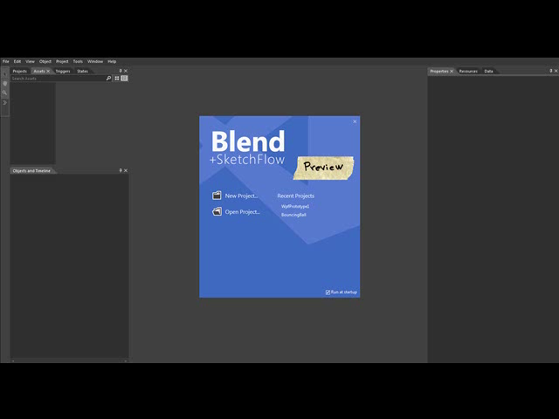
Screencast bouncing ball

Slide 49

http://www.pluralsight.com/courses/wpf-fundamentals

